Slide 1
Week Seven
app development: coding & business plan

Slide 2
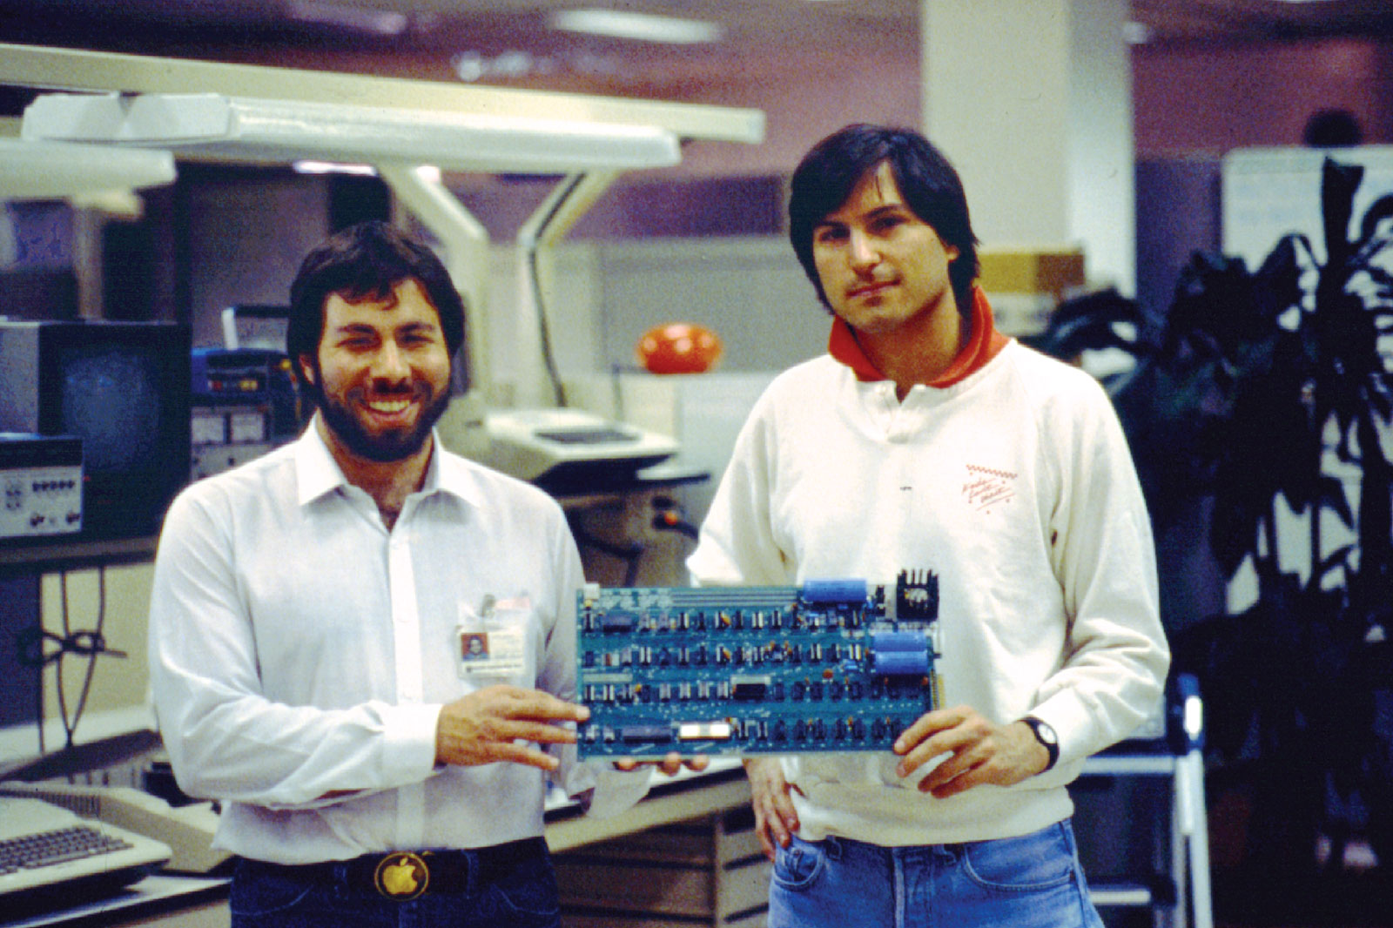

Slide 3
A Gantt chart uses a timeline to show when phases of a project are to be done and lists milestones and deliverables. It also identifies who on the team is responsible for those deliverables.
Draw up a table where the company team
a. lists tasks ("deliverables") by category ("milestones")
b. determines when these are to be done against the timeline and
c. identifies who is responsible (use initials or color coding)
Recommended Approach
*use the categories from Submission Guidelines to outline milestones to achieve
*use last week’s paper prototype to identify the individual tasks for coding deliverables (or even the components questionnaire from week 2) keeping in mind that a minimum viable product (MVP) is the goal
*use the Business Plan Checklist to further breakdown that category's tasks

Slide 4
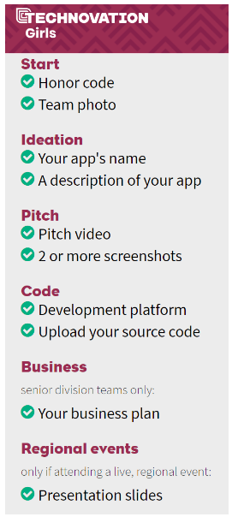
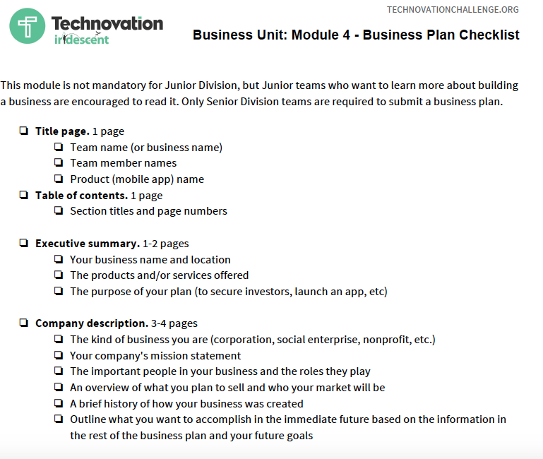
* junior team members should use the general categories from the Business Plan Checklist to organize the information they’ll need to prepare for pitches, as much of what goes into the business plan is used in the pitch presentation
submission guidelines
& demo video

Slide 5
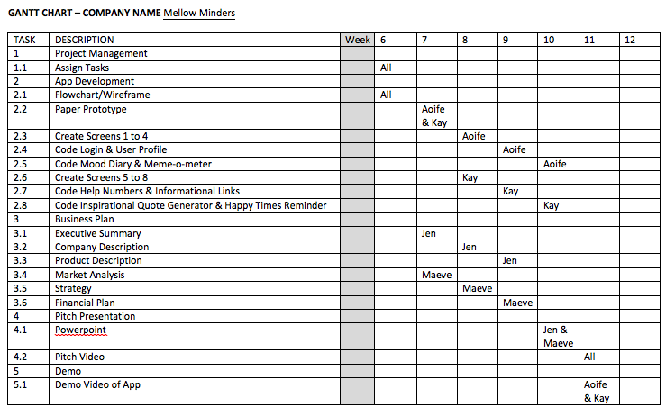

Slide 6
app development: coding
develop dynamic features like
- database use, ie. a log in
- API, ie. link that brings user to a website
- using phone functions, ie. GPS or camera
app inventor tutorials and open source blocks
http://appinventor.mit.edu/explore/ai2/tutorials.html

Slide 7
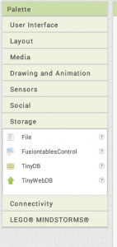
Example: Databases
Databases are found in Storage on the Palette in App Inventor. If your users' data does not need to shared with others or with you, the app company, then that data can be stored in a local database on the user's phone with TinyDB. Otherwise, you will need to use TinyWebDB. Keep in mind that TinyWebDB, although online, has usage limits and is suitable for prototypes only.

Slide 8
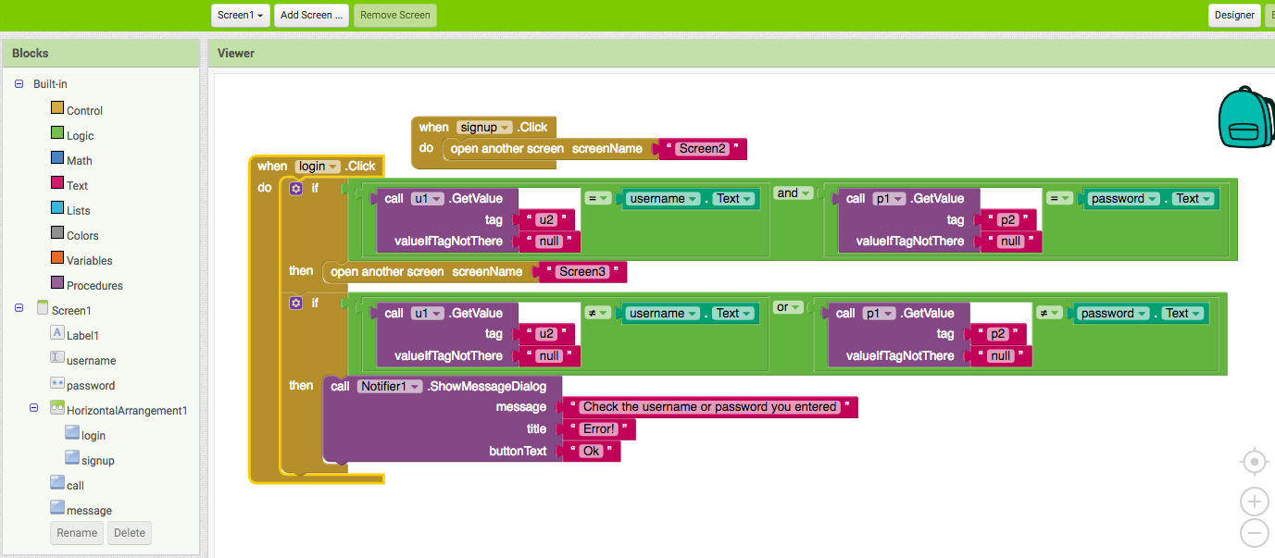
Components you will need to add on the ’Designer' for Screen1

Slide 9
tips
Judges must be able to use your app without assistance—show only what works—you can explain in your video what other elements will be added in the next iterations.
An app that functions and is easy to navigate will score well; don’t overcomplicate it or inform your design by what is on the checklist.
Since App Inventor is limiting, in terms of graphic design, find or create as many graphics as you can that can be uploaded into the media drawer and displayed as background, image or button.
Use open source to find examples of the code you want to do. Try googling as well as using search function in App Inventor’s “Gallery”

Slide 10
image as background
tip 3: find or create as many graphics as you can that can be uploaded into the media drawer and displayed as background, image or button.
created on powerpoint
image used
as animation canvas

Slide 11
app development: business plan
develop a business narrative
- Executive summary - A short and concise description of your business.
- Company description - Information on what you do, how and for whom.
- Products and/or service description - Define what products and/or services you sell, explain why it benefits your customers, and how your mobile app will be developed.
- Market analysis - Your consumer research and competitive analysis.

Slide 12
tips
Identify the problem you are solving, why you are solving this problem and how your solution is part of your company mission and for social good.
Clearly show that you understand the market you are entering: the number of potential users; the other products available to them; your unique selling point; and how you will reach users, including potential partners (like a charity in the space or government agencies).
Demonstrate your plan to make this a sustainable business by including revenue predictions, operations costs expectations, and product development strategies.
Use visual elements like pie charts, tables, graphs, etc. if possible— these can also be used in your presentation!!

Slide 13
graphs for predictions
tables for analysis
screenshots of product

